Slide 1
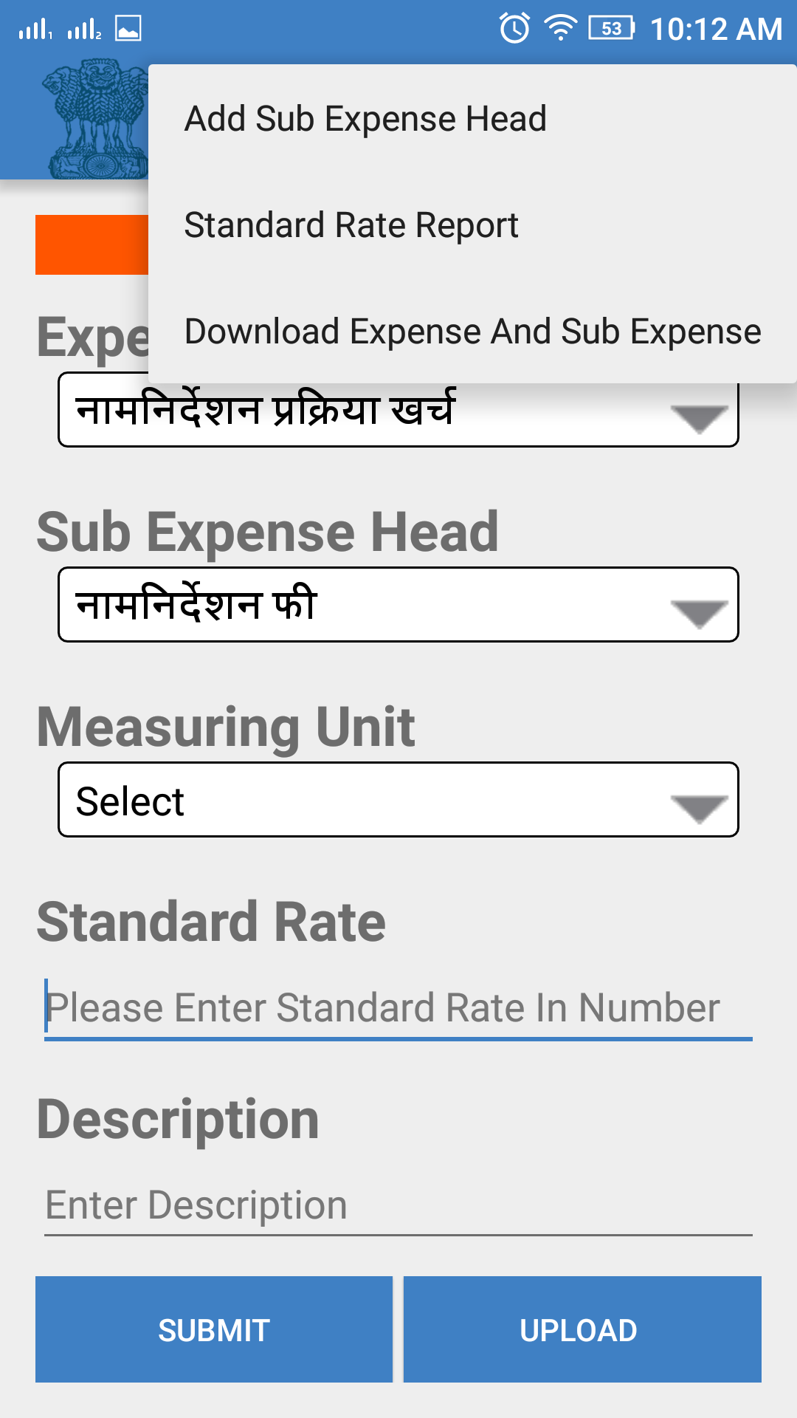
True Voter version 1.57
To Add new Sub expensed head click on ‘Menu’ option on the Standard Rate screen.
Select ‘Add Sub Expense Head’ option.

Slide 2
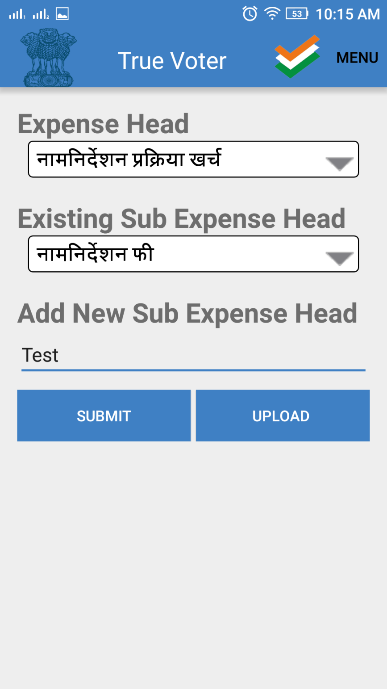
True Voter version 1.57
Select ‘Expense head’ from the list in which user wants to enter sub expense head.
Enter sub expense title in the text box of ‘Add New Sub Expense Head’.
Click on ‘Submit’ button to save.

Slide 3
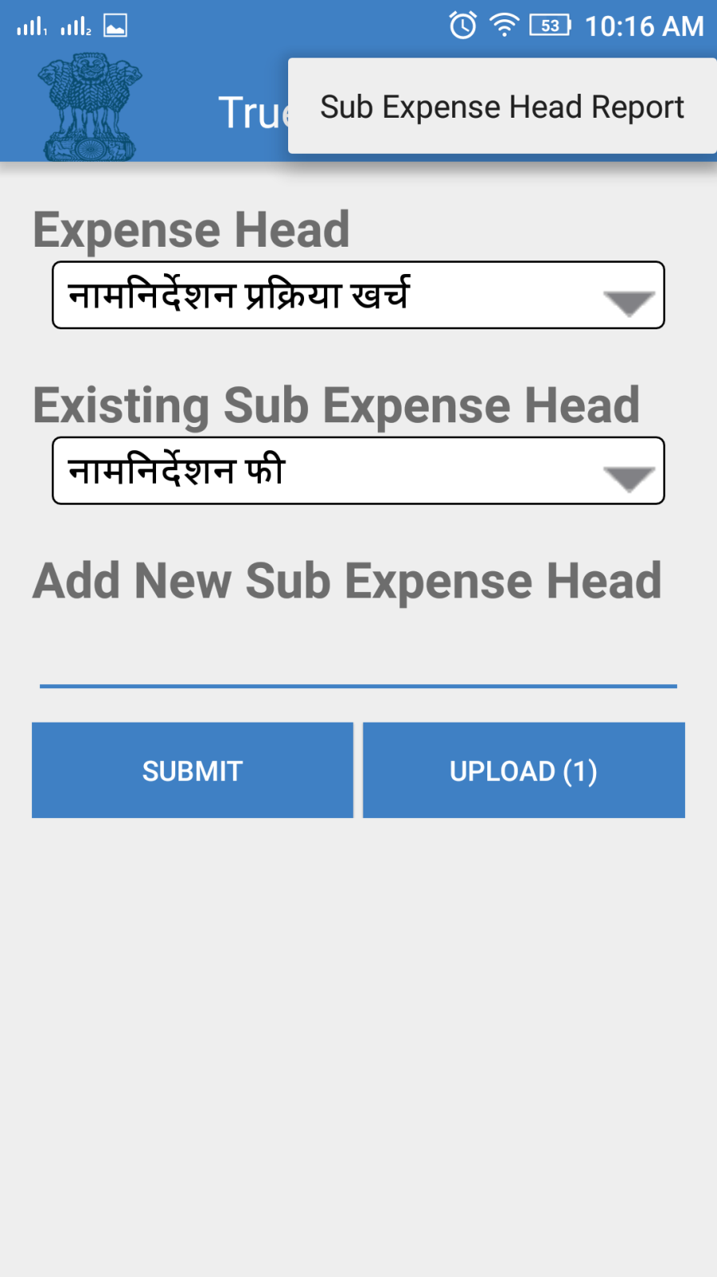
True Voter version 1.57
To view report for ‘Sub expense Head’ click on ‘Menu’ option on the header.
Click on ‘Sub Expense Head Report.

Slide 4
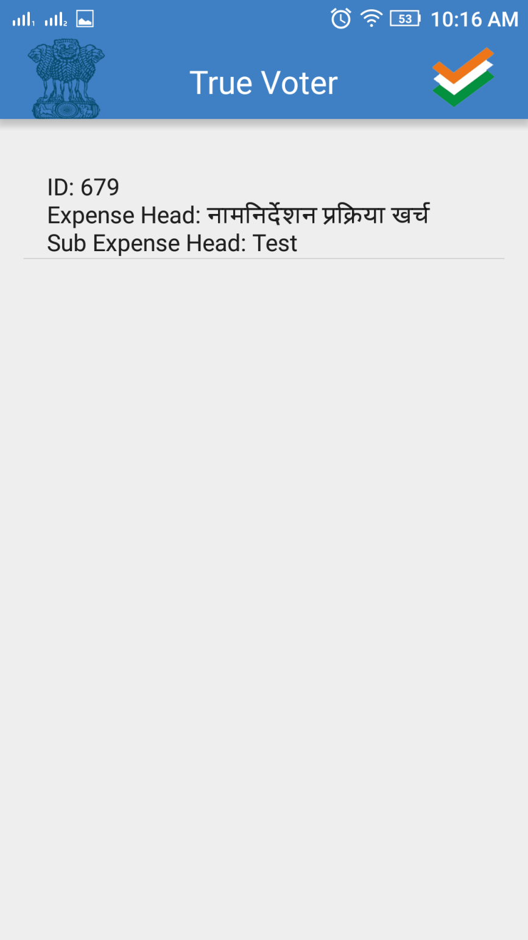
True Voter version 1.57
Report for the ‘Sub expense head will be disoplayed to the user as shown in the screen.
To update record click on the record.

Slide 5
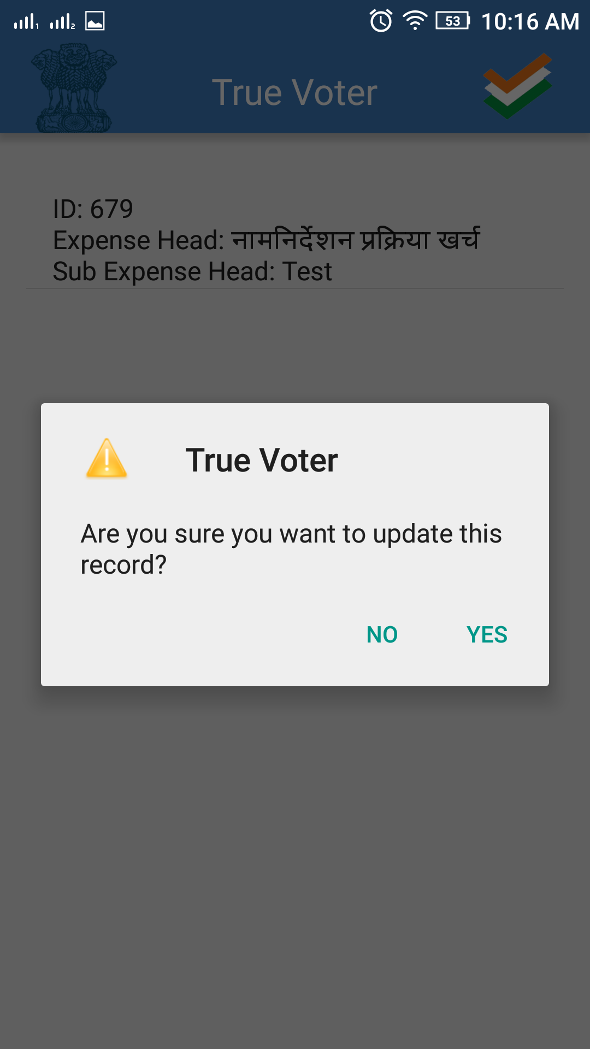
True Voter version 1.57
User will display message that ‘Are you sure you want to update this record?’
Click on ‘yes’ to uopdate record.

Slide 6
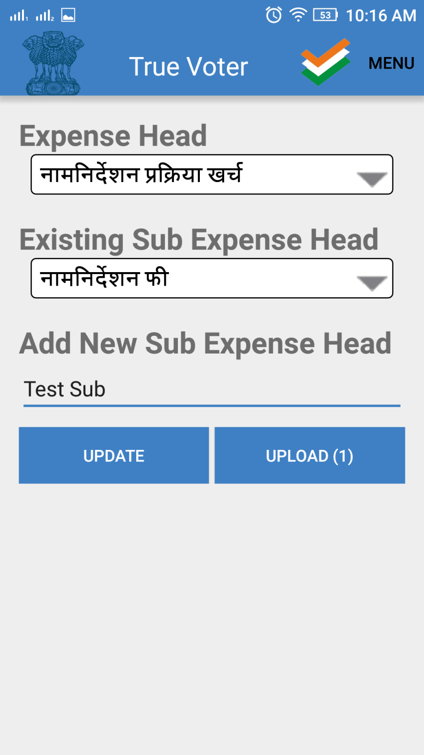
True Voter version 1.57
User can make changes.
Click on ‘Update’ button to update record.
User can update and delete record before upload action.

Slide 7
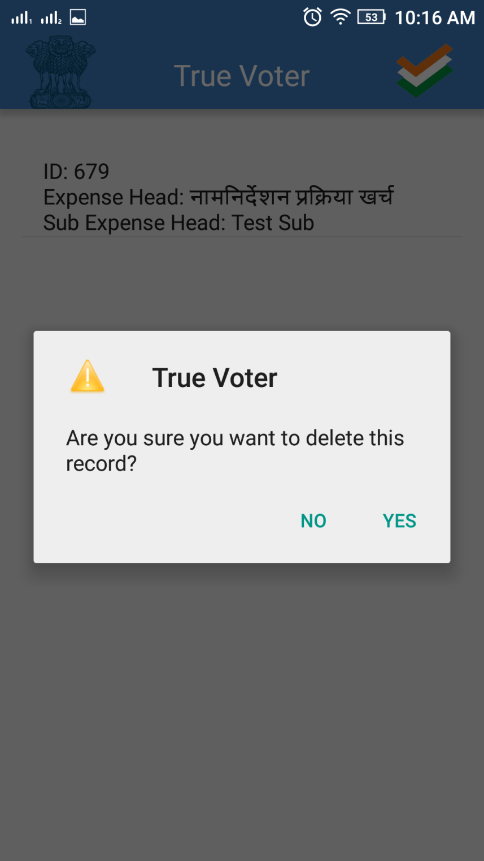
True Voter version 1.57
If user wants to delete record.
Click on ‘Menu’->’Sub exlense Head Report’.
On the report page click and hold record.
User will display message on screen that ‘Are you sure you want to delete this record?
Click on ‘yes’ to delete record.

Slide 8
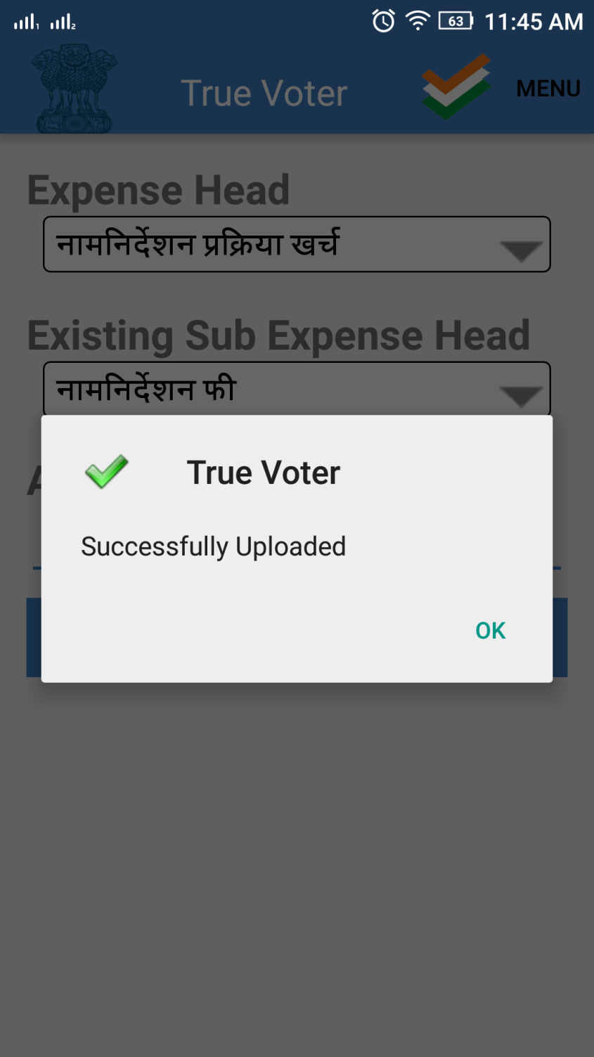
True Voter version 1.57
Click on ‘Upload’ button to upload record on the server.
User will get message that ‘Successfully Uploaded’.
Note- user can update and delete record before upload action.

